Slide 1
Approaches to Analyzing the Genetic Predisposition to Autism
Literature Review

Slide 2
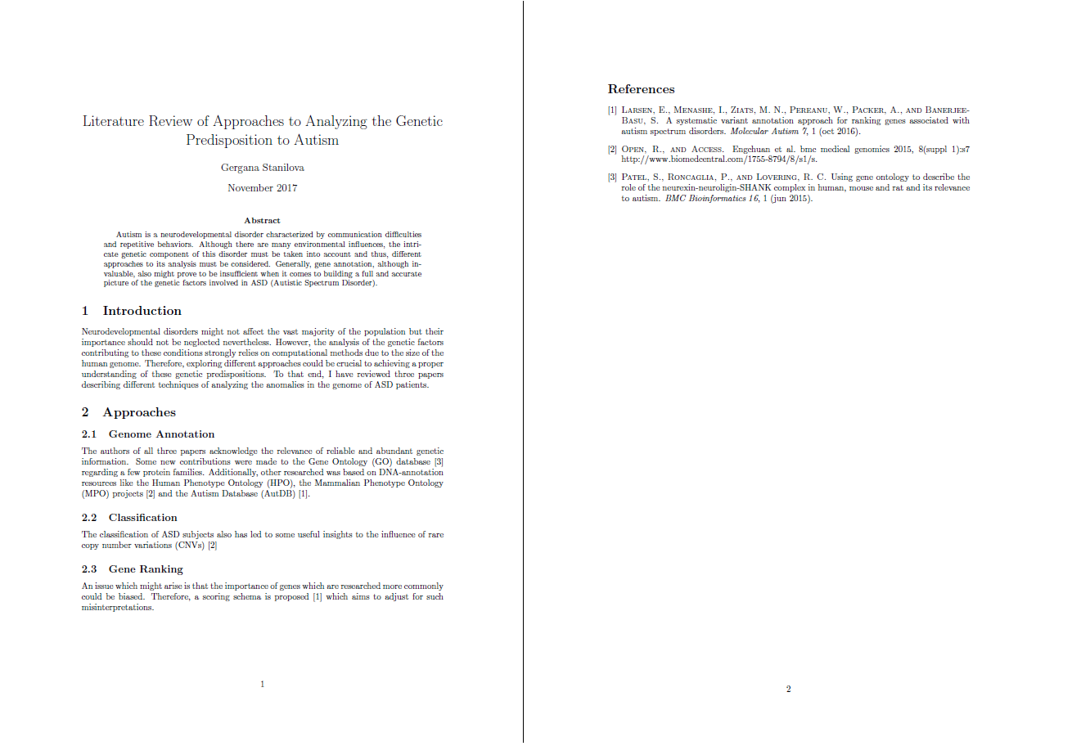
Structure
Latex Template
Abstract
Introduction
Body - thematically organized
References – using .bib (generated by JabRef)

Slide 3
Content
3 different approaches:
3 papers from reliable sources: - BMC Bioinformatics (2015) - Molecular Autism (2016) - BMC Medical Genomics (2015)
Genome Annotation - new relevant genes described
Classification - new insights after classification of ASD subjects
Gene Ranking - not only cataloging but also ranking

